Slide 1
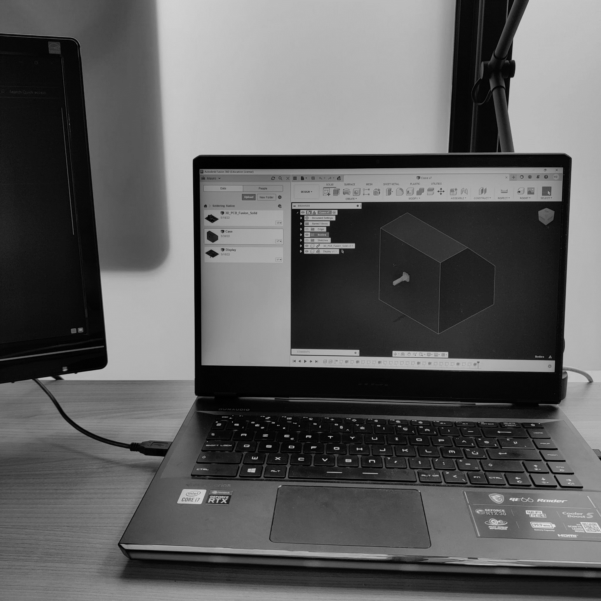
Soldering station
Mauro De Bruyn
01/06/2022

Slide 2

Introduction
Cheap high end
Left hand use (soldering iron)
Encoder
Display
On/Off switch
External fuse
Main reason

Slide 3
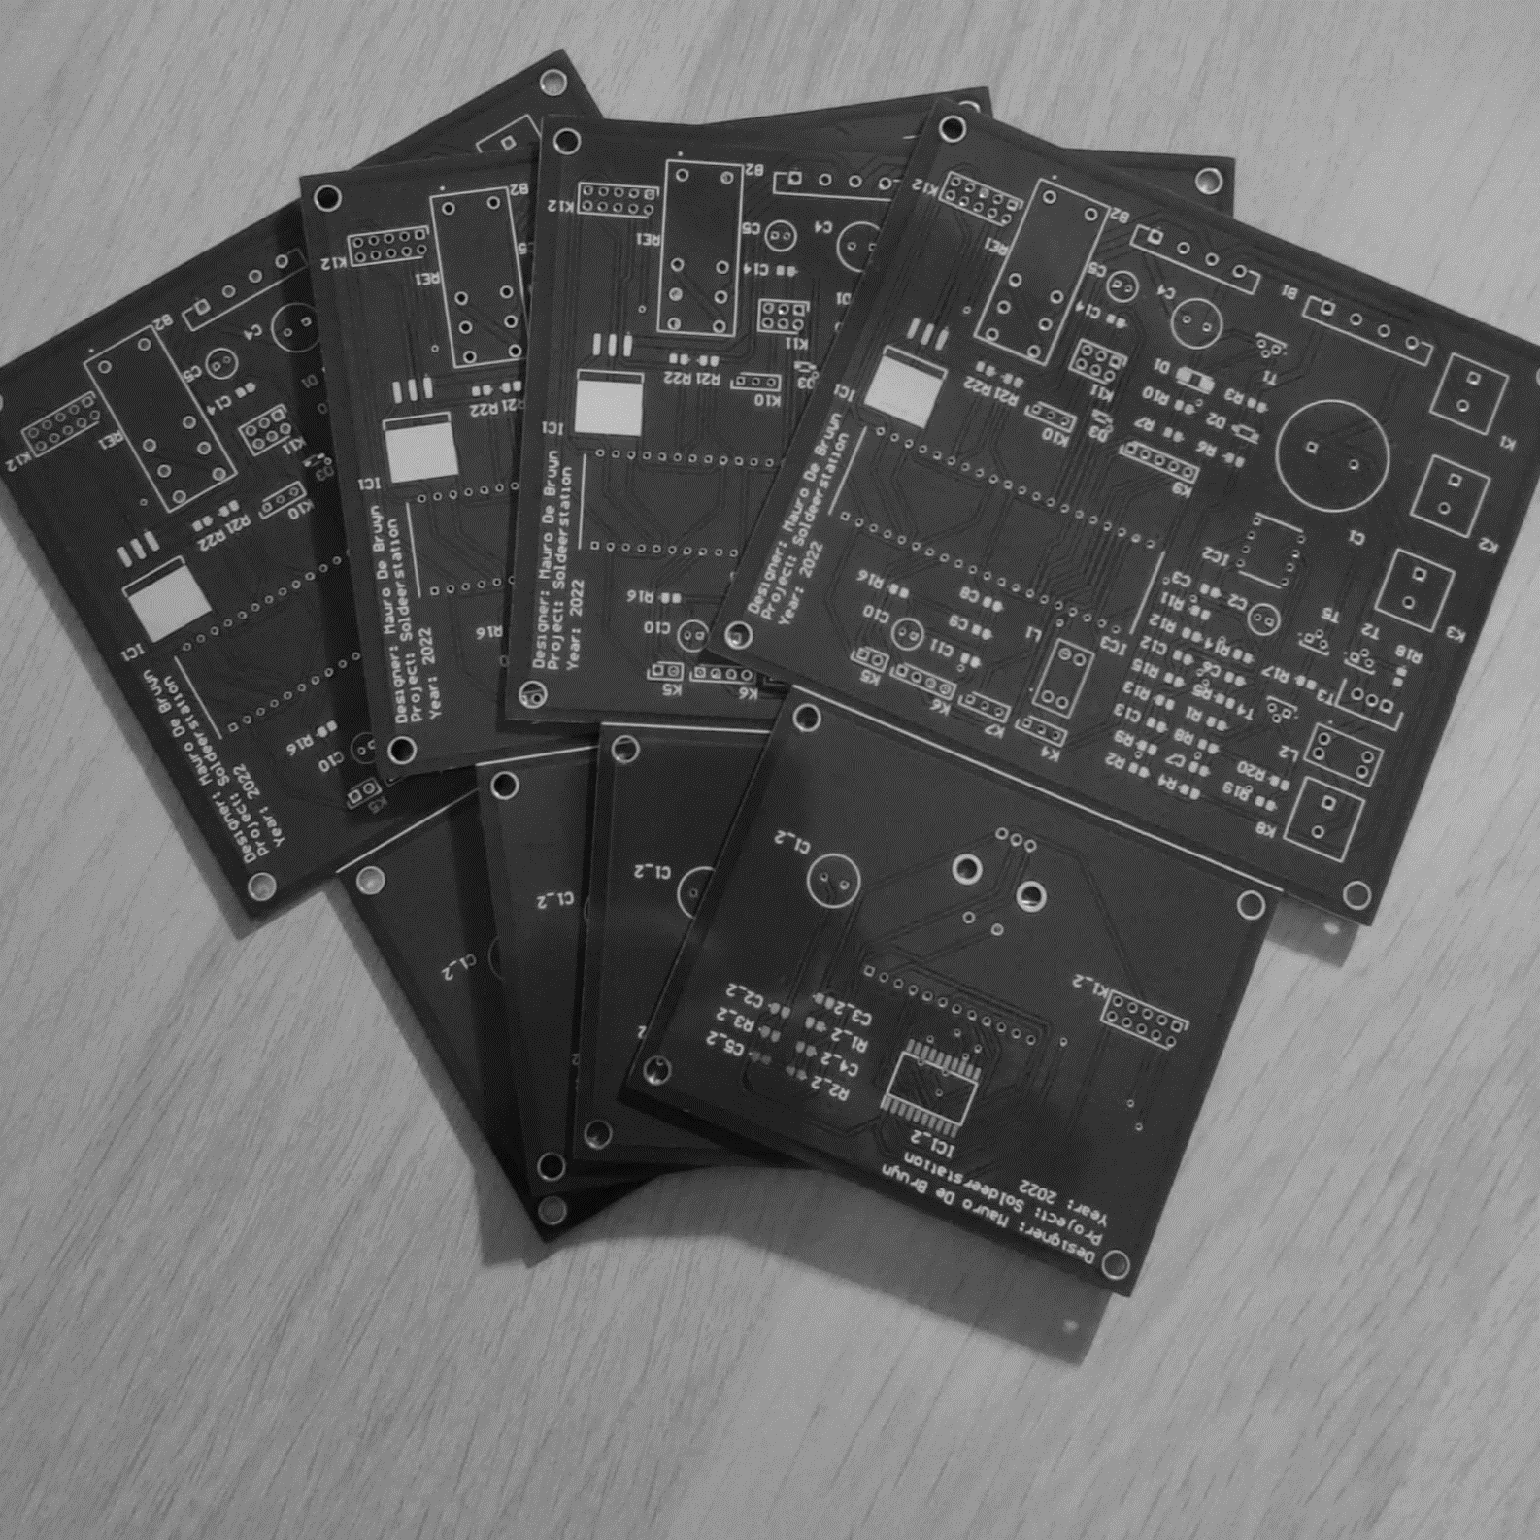
Steps
Schematics (Elektor)
PCB (Altium)
Case (Autodesk Fusion)

Slide 4
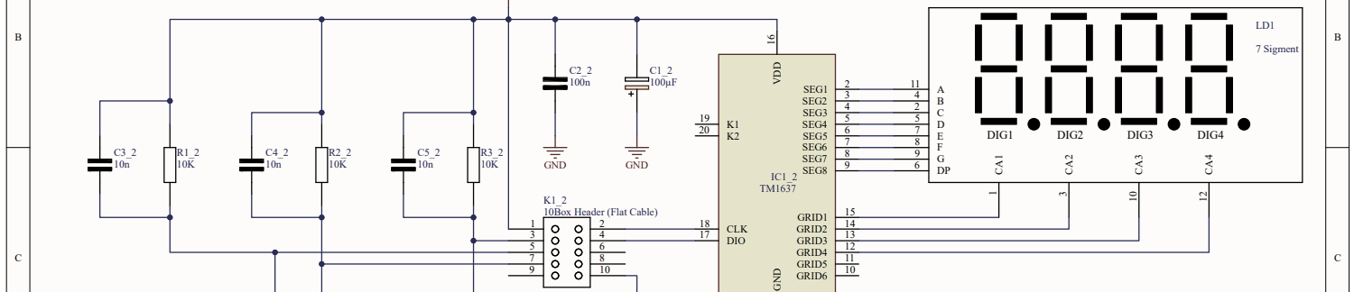
Schematics
Elektor
Altium designer
5 Schemes

Slide 5
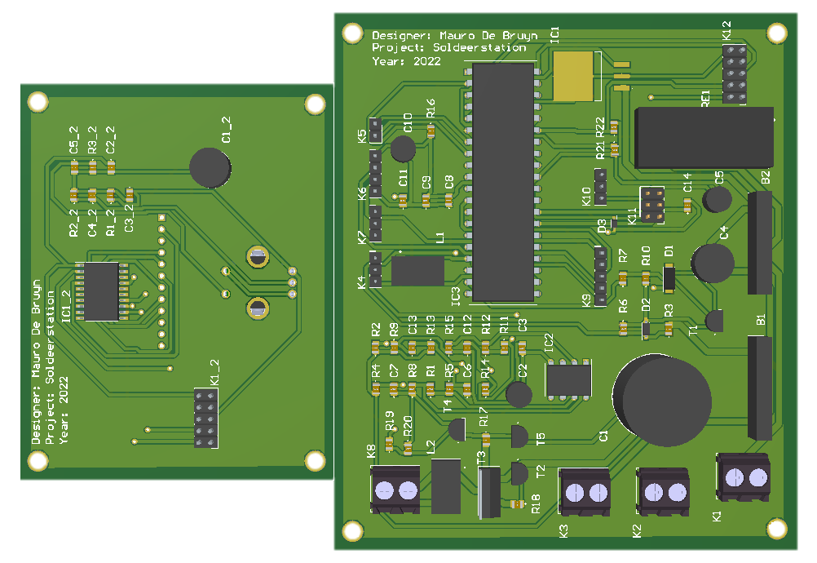
PCB
Altium
Power lines
Changing footprint transistor
Placing components by group
2 PCB’s (Flatcable)

Slide 6
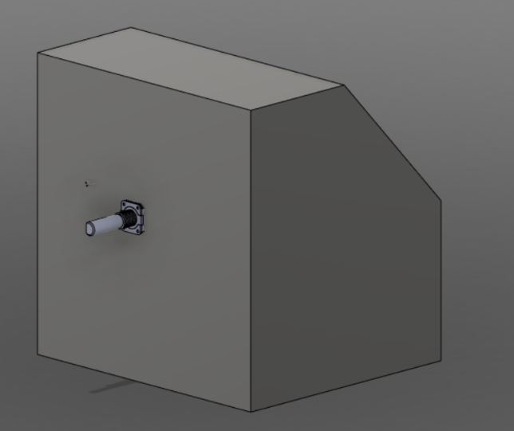
Case
Autodesk Fusion 360
Rounded case
Left hand use

Slide 7
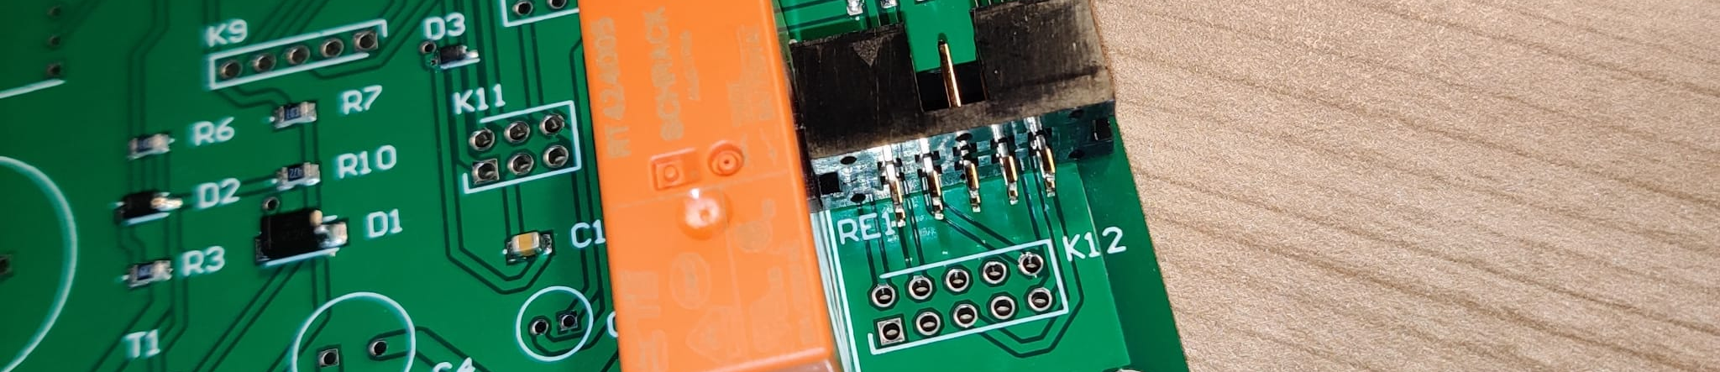
Problems
10 box header K12
Coil L1

Slide 8
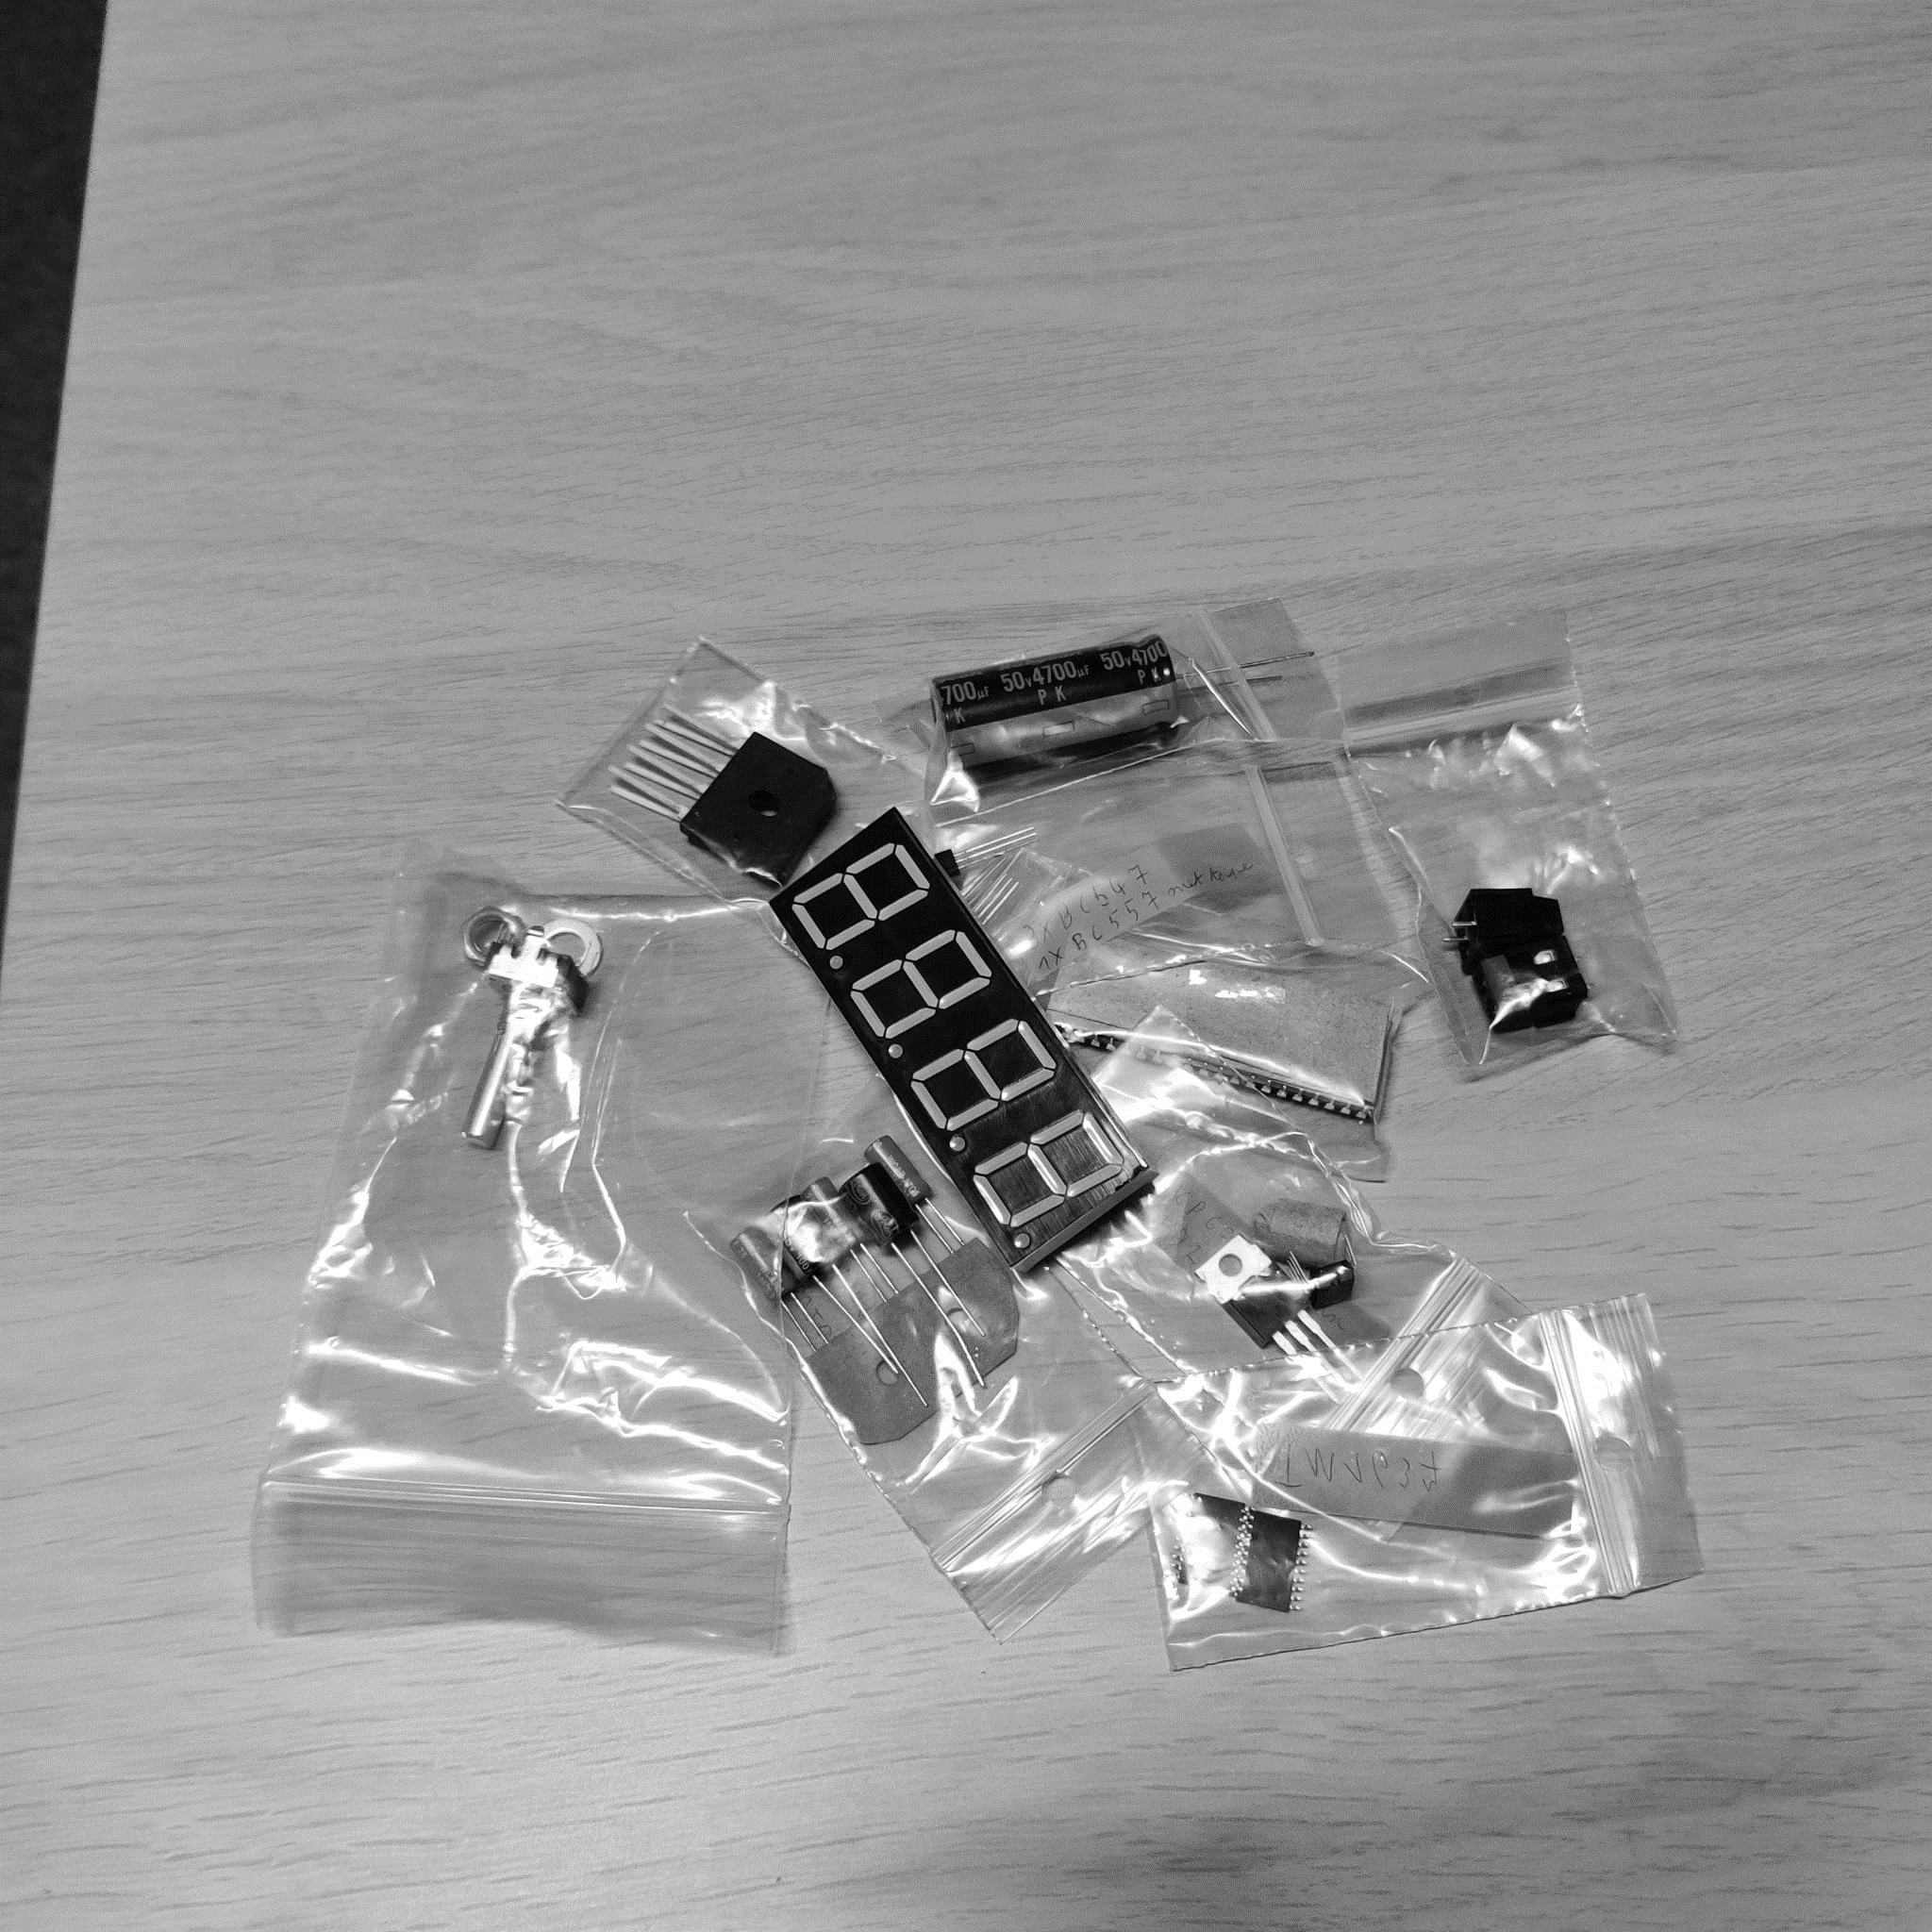
Overall
Fast results
A to Z

Slide 9
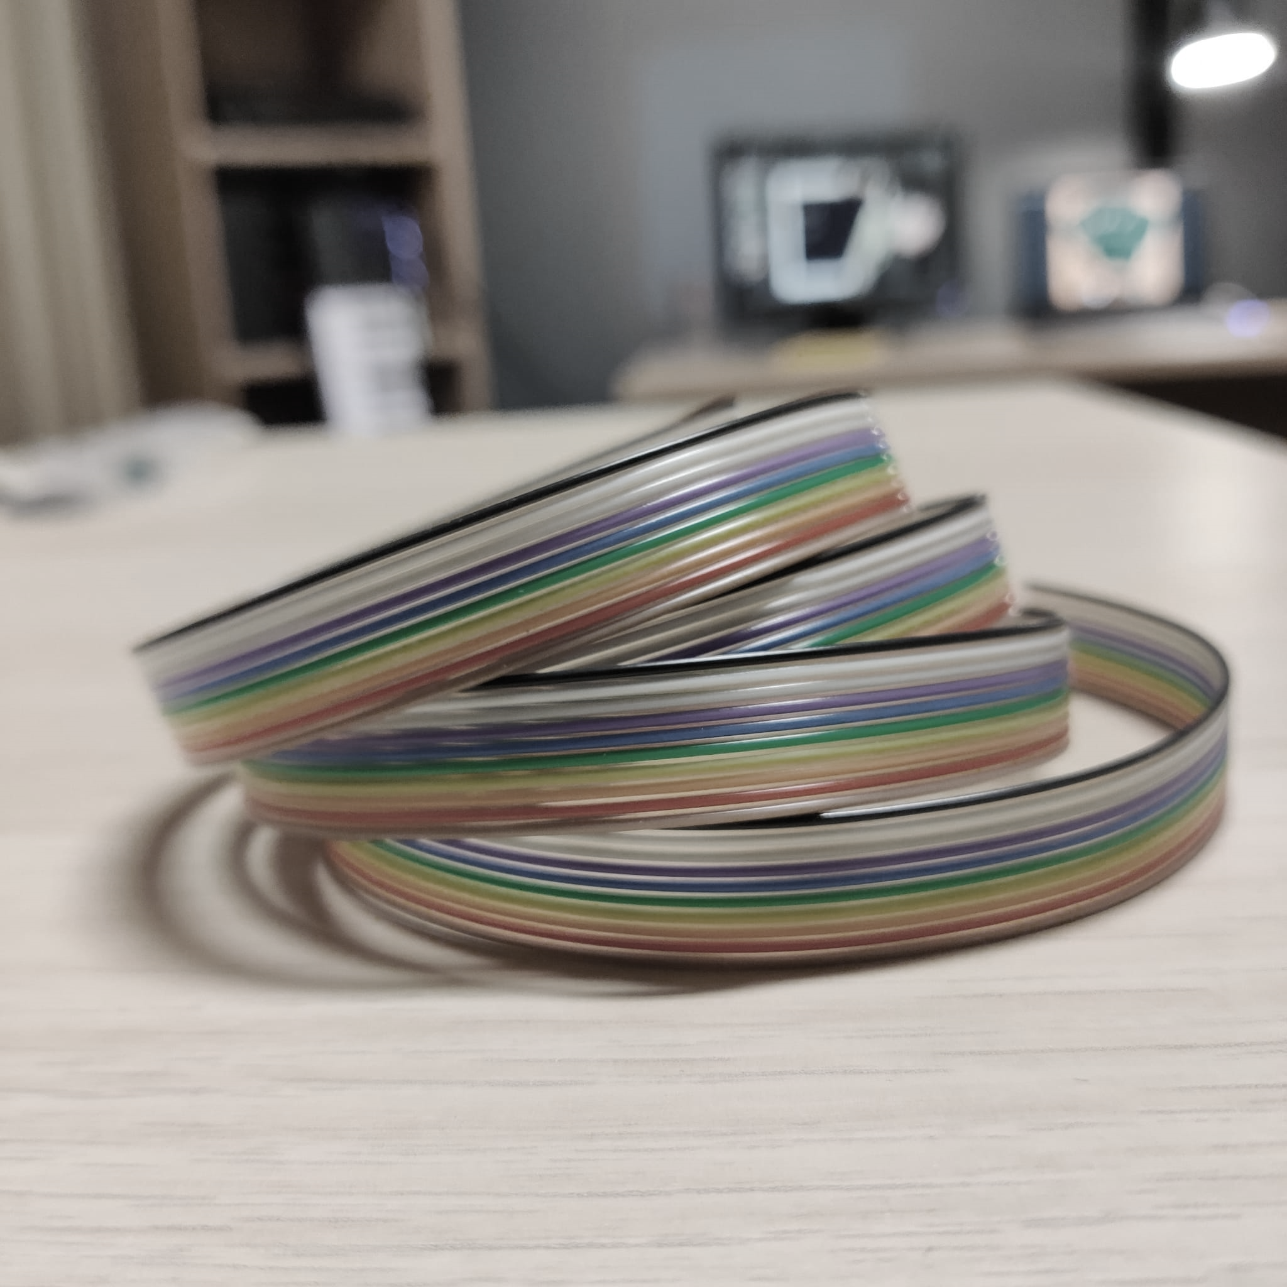
Questions?

